Slide 1

RANKL Expression as a Measure of Osteocyte Apoptotic Signaling in Confined Space
Department of Biomedical Engineering
Sean McCutcheon
Vazquez Laboratory and Schaffler Laboratory
Biomedical Engineering Society Annual Meeting
October 12th, 2017

Slide 2
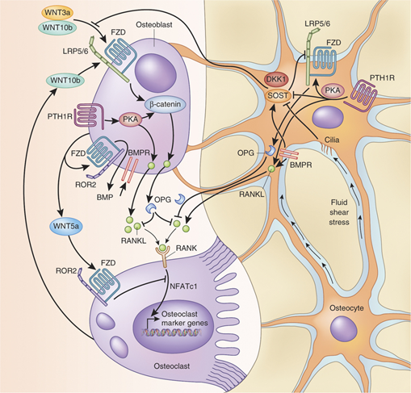
Background: Bone Signaling - RANKL
Osteocyte Role in Catabolic Signaling
Paracrine Signaling - DKK1, Sclerostin, PGEs
Endocrine Signaling - PTH
Receptor activator of nuclear factor kappa-B ligand (RANKL)
  Osteoclast precursor differentiation and the initiation of resorption
Apoptosis
  Purinergic “find me” signal and bystander effect
  Initiation of the RANKL pathway in adjacent osteocytes?
Critical determinant of bone homeostasis and mechanical integrity
Figure 1: Partial schematic of bone homeostatic signaling (Baron and Kneissel. Nat Med, 2013).
Notes:
RANKL triggers osteoclast percurosr recruitment and differentiation
Proposed that upregulation of soluble RANKL is due to purinergic signaling from apoptotic osteocytes
Critical in bone balance and mechanical integrity

Slide 3

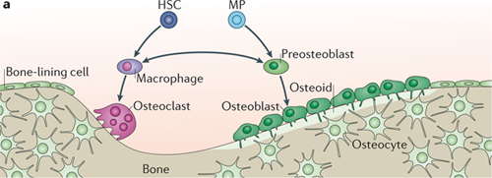
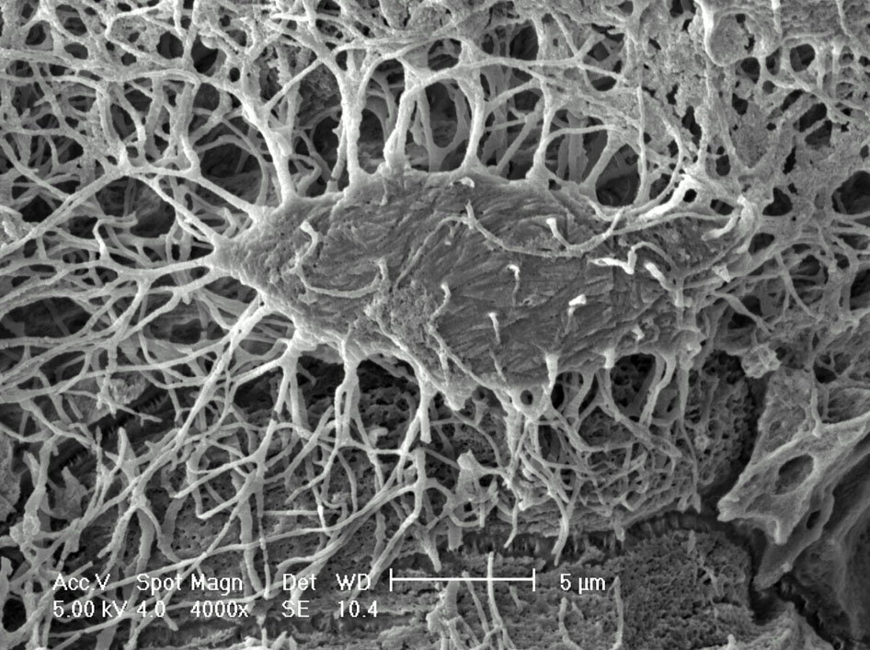
Background: Osteocyte In Vivo Geometry
Figure 2: Bone Cell organization (Long. Nature Reviews Molecular Cell Biology, 2012).
Figure 3: SEM of osteocyte (Pajevic. IBMS BoneKEy, 2009).
Bone Cell Geometry
Osteoblasts and osteoclasts sit on the bone surface, while osteocytes reside within the confined Lacunar Canalicular System (LCS)
  The osteocyte cell body sits in a 8-20µm diameter lacuna
  Osteocyte processes extend into 100-200nm diameter canaliculi
Notes:
Osteoblasts exist within highly confined space called the LCS
They communicate with each other and cells on the bone surface by means of their processes
The communication is dependent on interactions (mechanobio and diffusible signaling) within these nanometer scale spaces

Slide 4
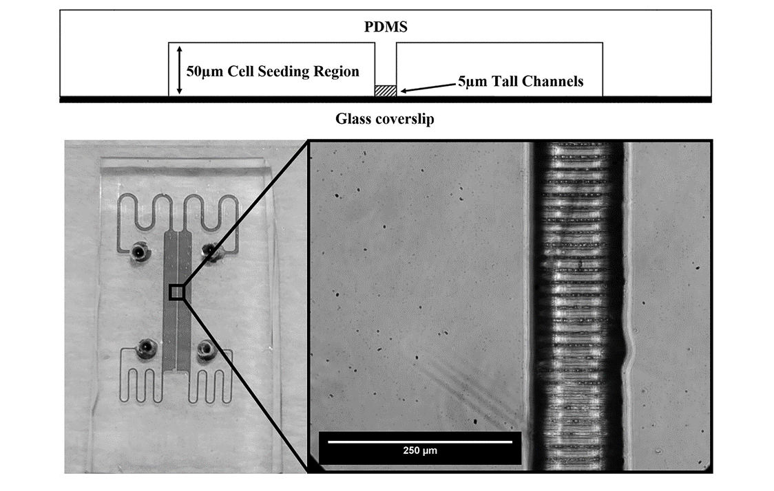
Macro-micro-nano (Mµn):
Device Design and Fabrication
Two 1mm-wide x 10mm-long seeding regions separated by a 100µm-wide channel array
Channel widths measure ~900nm - 1µm, separated by 10µm
Produced by 2-step soft photolithography
SU-8 photoresist on Si mold was silanized and used to cast PDMS devices.
Devices were bonded to glass slides by ozone plasma treatment.
For further info on device fabrication and validation see poster tomorrow or read “A multiscale fluidic device for the study of dendrite-mediated cell to cell communication” McCutcheon et al, Biomedical Microdevices (2017).
Figure 4: Profile view of bonded device (top) and brightfield image of bonded PDMS device with channel array detail (bottom).
Notes:
Able to demold from Si/Su-8 master utilizing silanization and resolve channels
Able to form fluidic seal and have fluid flow within the nanochannels
Image shows fluidic setup

Slide 5
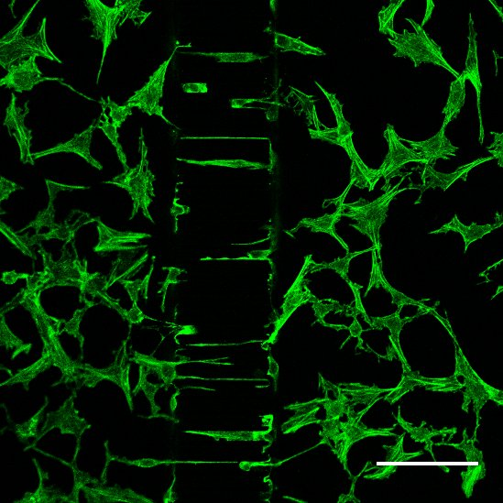
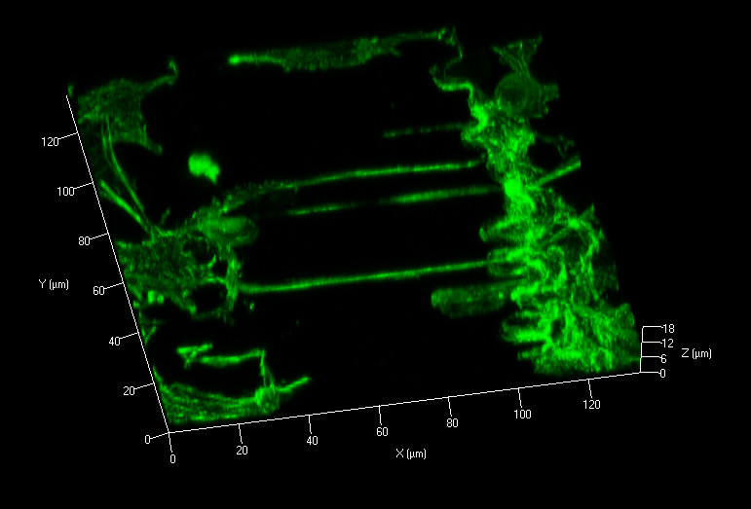
Osteocytes in the Mµn: Process Extension
Interior surfaces of the Mµn coated with 30 µg/mL fibronectin
MLO-Y4 osteocyte-like cells plated at 1 x 10⁶ cells/mL every 24 hrs for 3 days. And cultured in conditioned medium for 4 additional days
Actin visualized by phalloidin staining to view process formation
~60% of channels had either full or partial process in-growth
Demonstrates the ability of the system to mimic the in vivo condition
F-actin
Figure 5: MLO-Y4 cells in the Mun device stained with phalloidin. Orthogonal view (left) and 3d rotated view (right), scale bar 100µm.

Slide 6
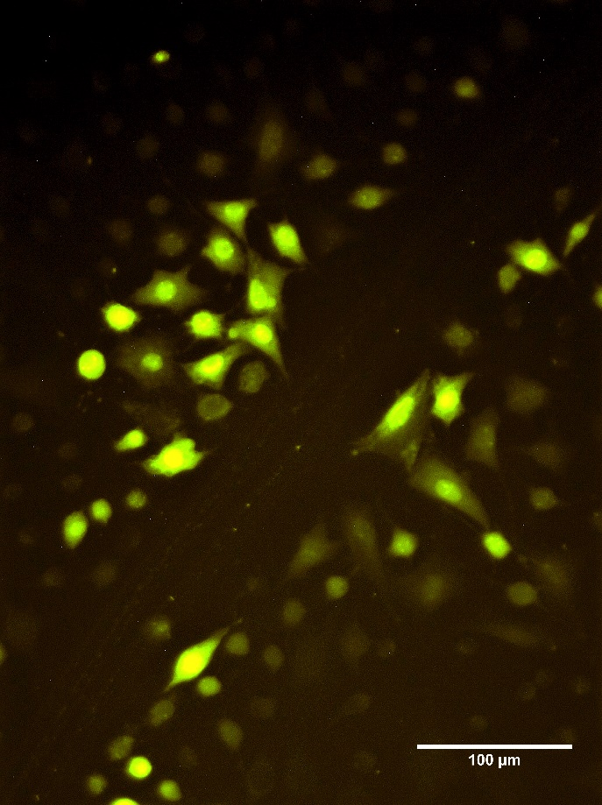
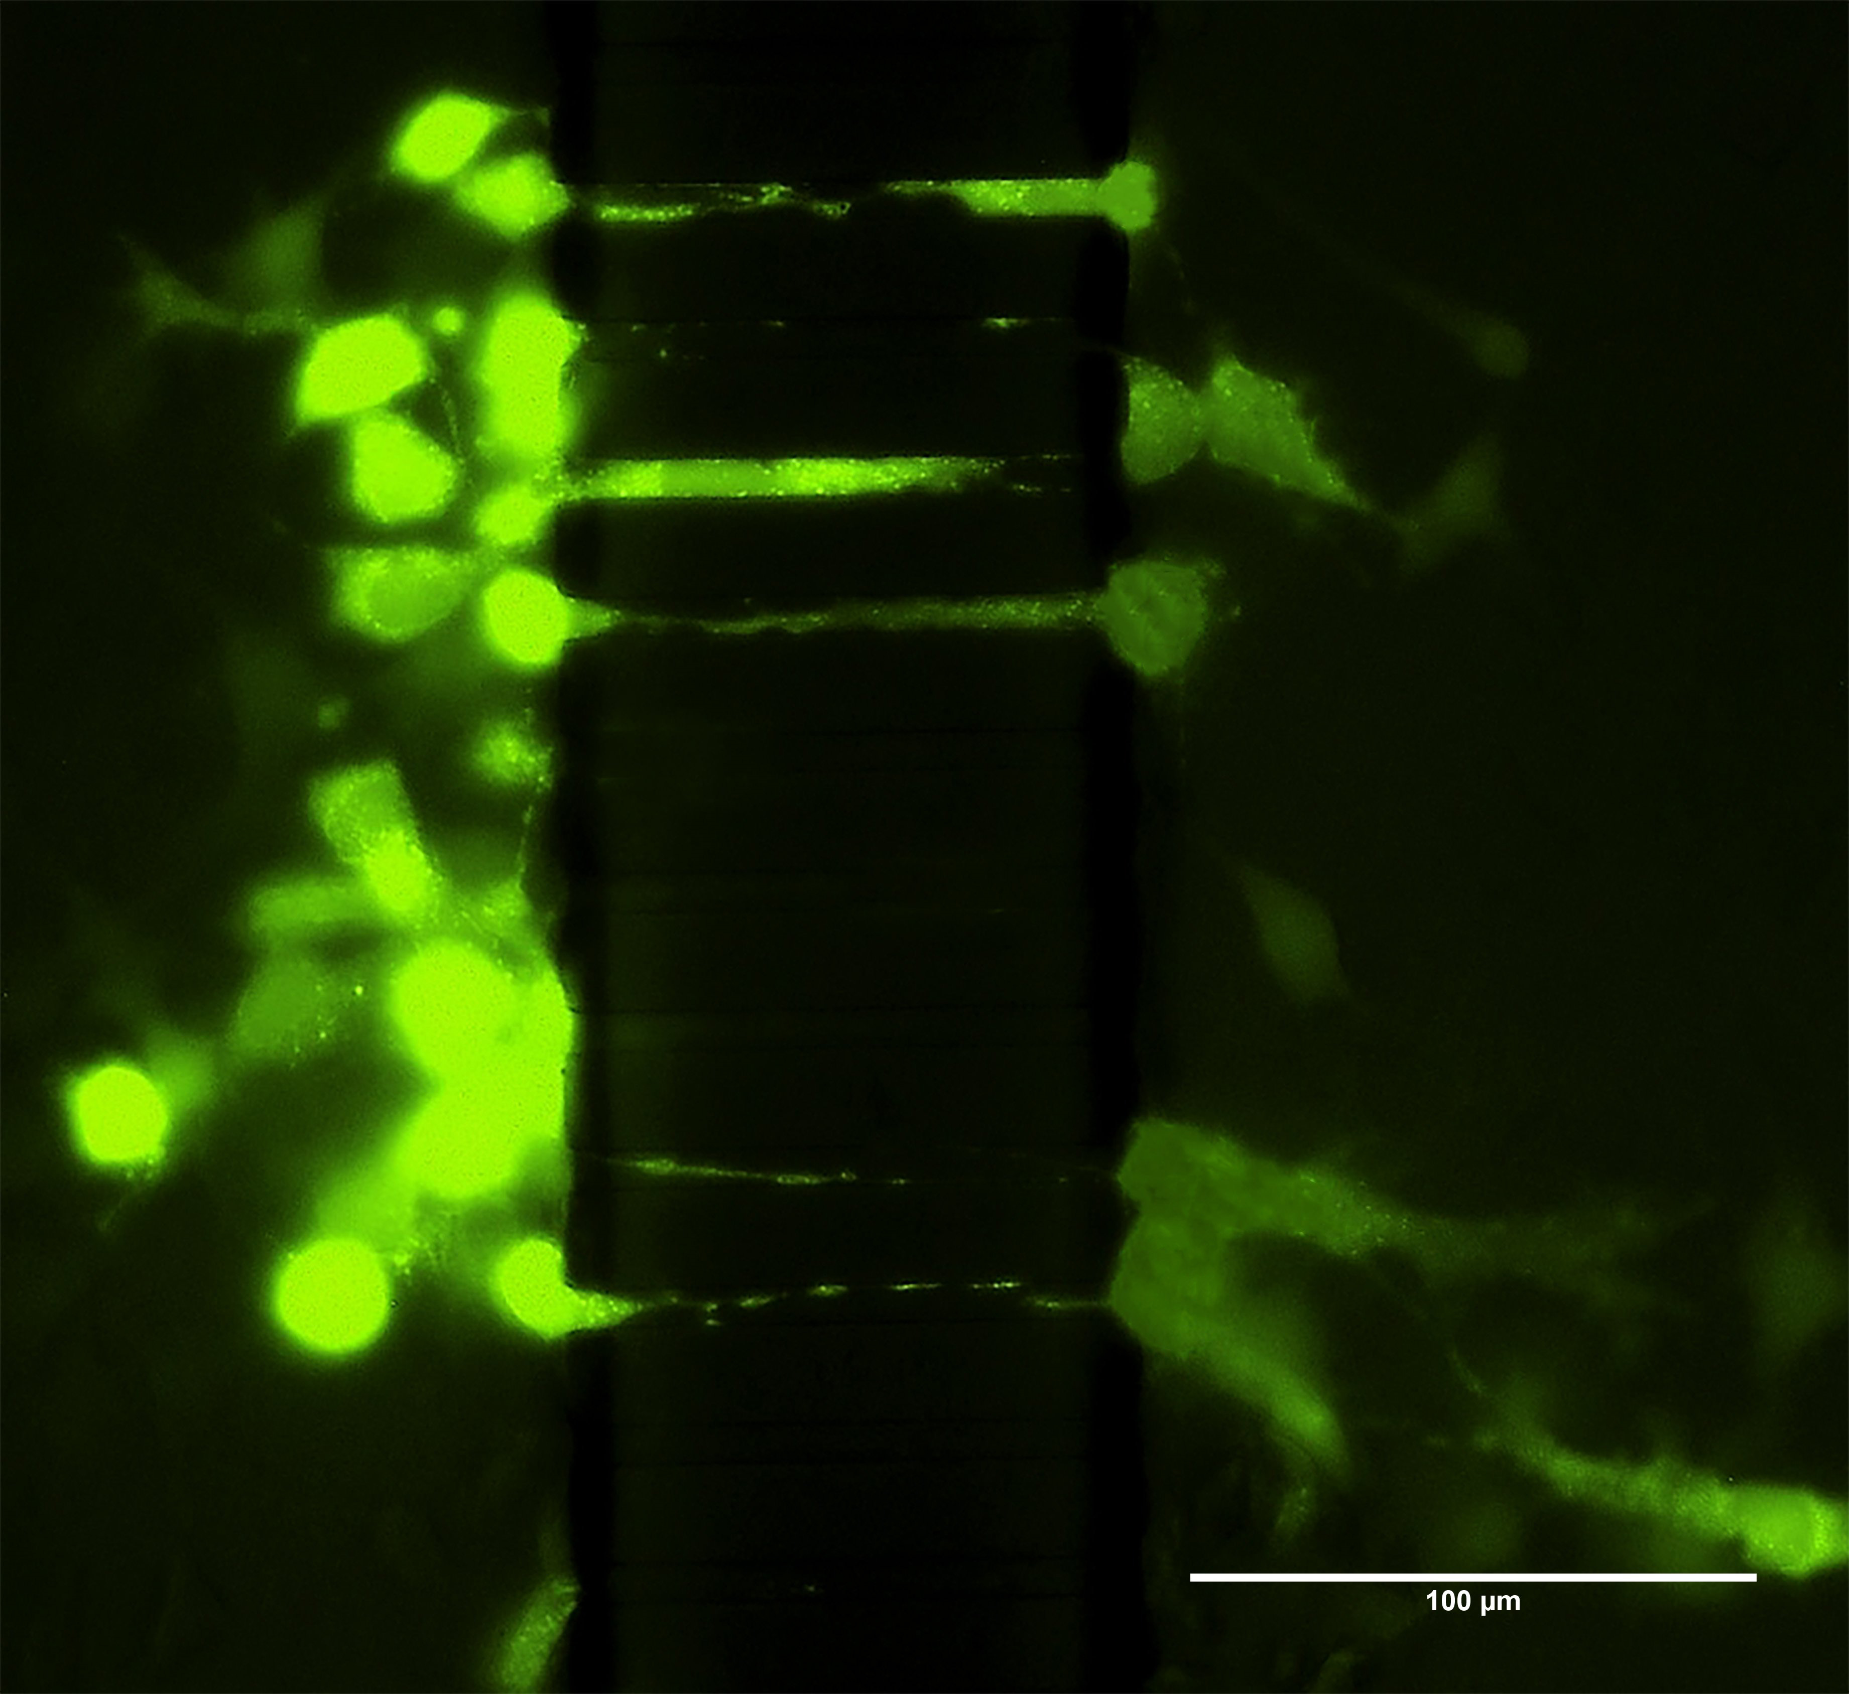
Osteocytes in the Mµn: Gap Junction Functionality
Open Plate Scratch Test
Lucifer Yellow
Mµn
Calcein-AM
MLO-Y4 RANKL reporter cells (see next slide) were evaluated for functional gap junctions by dye transfer scratch assay using connexin permeable lucifer yellow (1%)
Cells were plated as previously described, and at day 7 Calcein-AM (10µM) loaded cells were “parachuted” on one side of the Mµn and imaged for dye transfer to opposite side at 2 hrs
Open plate test showed robust dye transfer and therefore functional gap junctions
Mµn test showed formation of functional gap junctions across the channel array
Further demonstrates the ability of the system to mimic the in vivo condition
Figure 6: Dye transfer scratch assay using connexin permeable lucifer yellow to assess gap junction formation and functionality in an open plate.
Figure 7: Dye transfer parachute assay using connexin permeable lucifer yellow to assess gap junction formation and functionality in an open plate.
Notes:
Lucifer yellow 1% and calcien am 10uM as per Donahue group citation (2000)

Slide 7
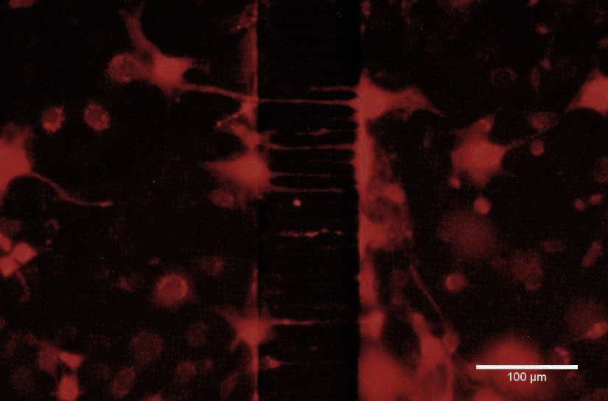
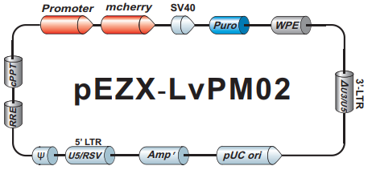
RANKL Reporter System
Lentiviral transduction of cDNA with RANKL Promoter ahead of mCherry promoter
Transduced at MOI of 10 and selected by puromycin resistance (1 µg/mL)
Metric: proportion of cells above intensity threshold or number of “activated osteocytes”
Threshold = RIU ≥ 0.5 x Max_{Unheated Control}
RANKL
RANKL
Figure 7: cDNA RANKL reporter plasmid (Genecopoeia).
Figure 8: MLO-Y4 cells transduced with RANKL reporter in Mµn.
Notes:
Details for each component of the cDNA sequence

Slide 8
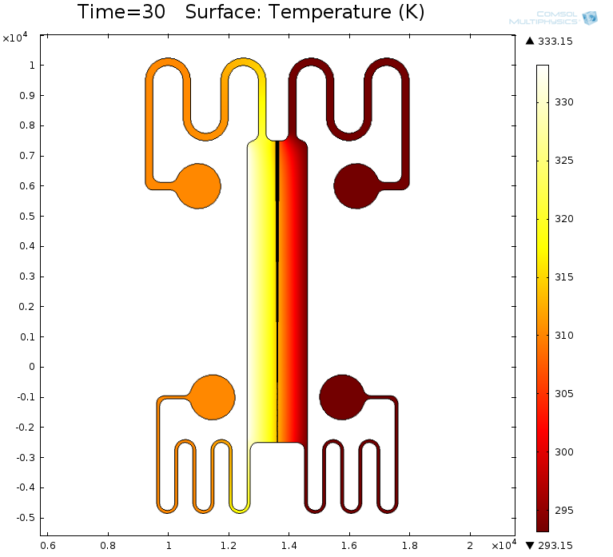
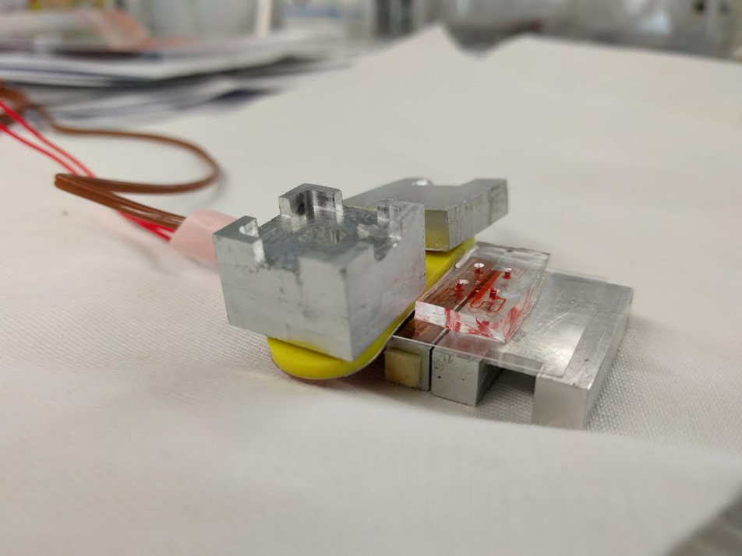
Apoptosis Induction: Heat Stress
Heat sequestration within device possible with 60°C heating element and chilled 4°C heat sink
Temperature max on unheated side = 37°C
Heating Element
Heat Sink
Figure 9: Heat distribution within the device with 60°C (333 K) heat source on left and 4°C (277 K) sink on right after 30 seconds.
Figure 10: Heating apparatus
Notes:
Heat on the untreated side doesn’t go over 310K (37C)

Slide 9
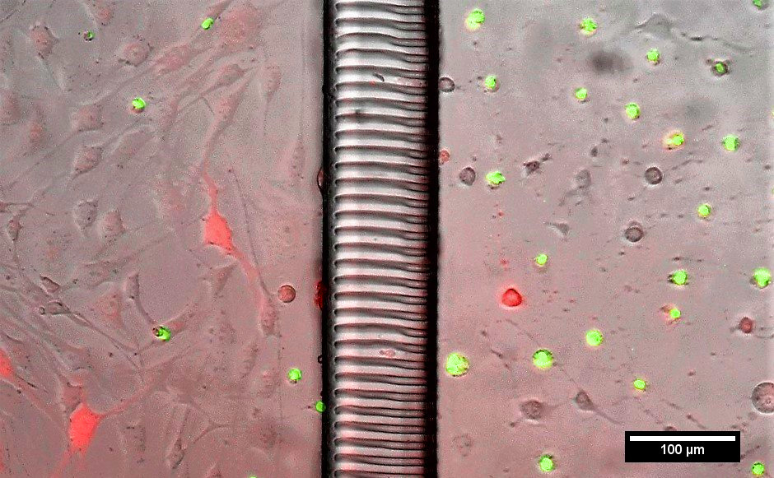
Apoptosis Induction in the Mµn
Found best heating condition was 60°C for 30 sec
Able to isolate apoptosis on the heated side of the Mµn
Maximal apoptosis (Caspase 3 activation) was 15% on the unheated side 12 hrs post-heating
Average caspase 3 activation was 68% on the heated side 12 hrs post-heating
RANKL
Casp3
Figure 11: MLO-Y4 RANKL reporter cells in Mun 12 hours-post heating. Heated side (right) and unheated side (left).

Slide 10
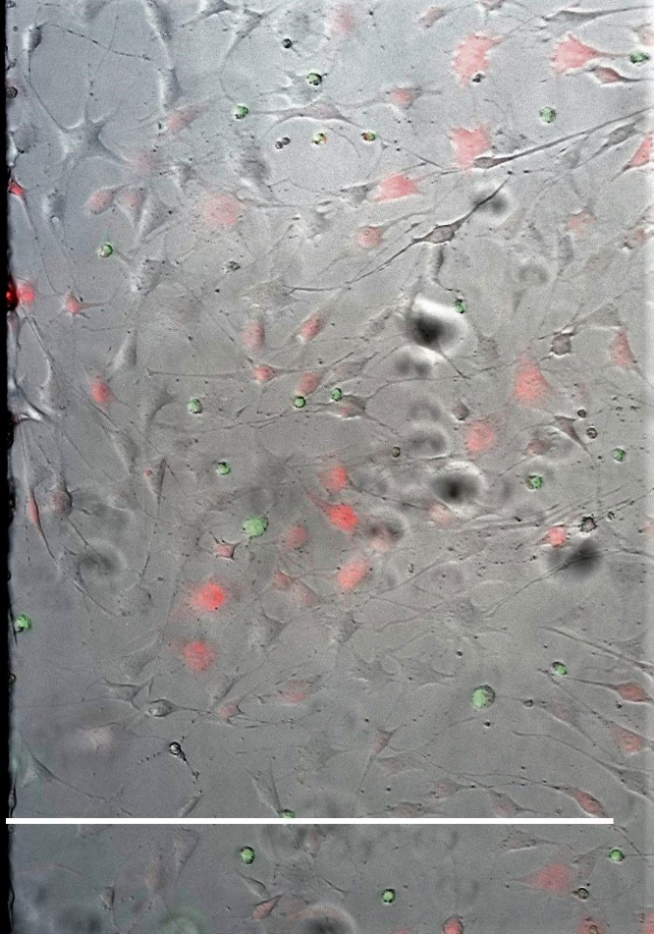
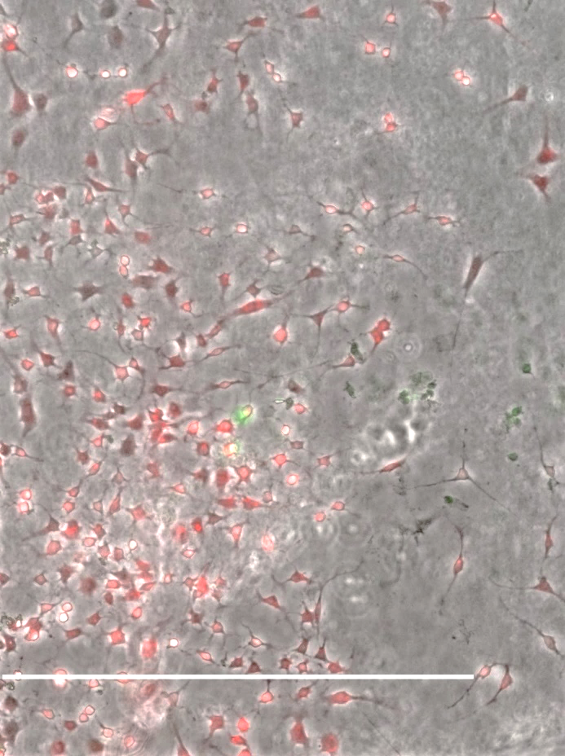
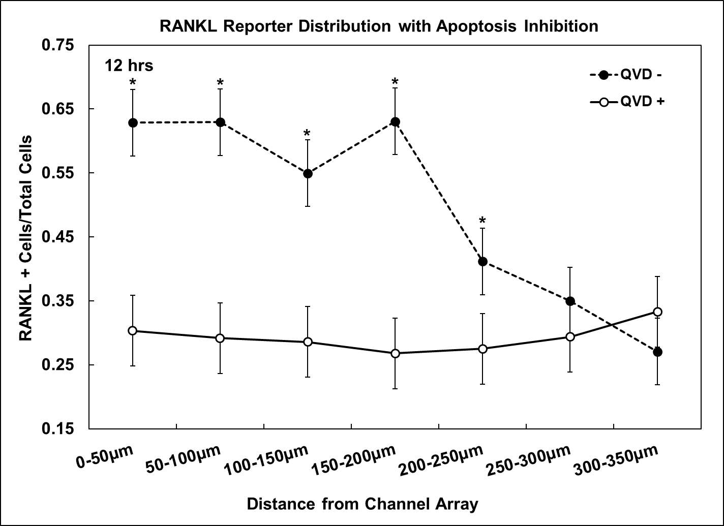
RANKL Reporter with Heat Stress and Apoptosis Inhibition
Heat Stress QVD +
RANKL
Heat Stress QVD -
RANKL
Casp3
Casp3
350 µm
350 µm
Distance from Array
Distance from Array
Figure 12: MLO-Y4 RANKL reporter cells in unheated side of Mµn 12 hrs post-heating with 10uM QVD.
Figure 13: MLO-Y4 RANKL reporter cells in unheated side of Mµn 12 hrs post-heating with 0uM QVD.
Figure 14: RANKL reporter distribution as function of distance from channel array (apoptotic region) *p<0.05 vs QVD - unheated control.

Slide 11
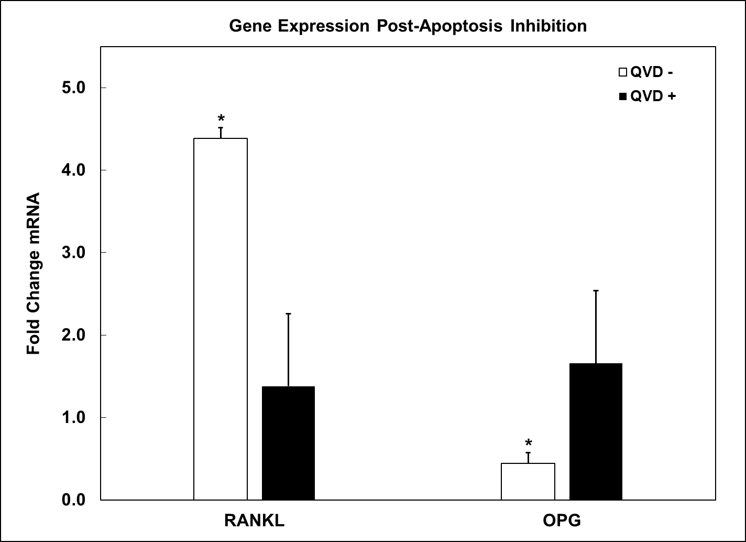
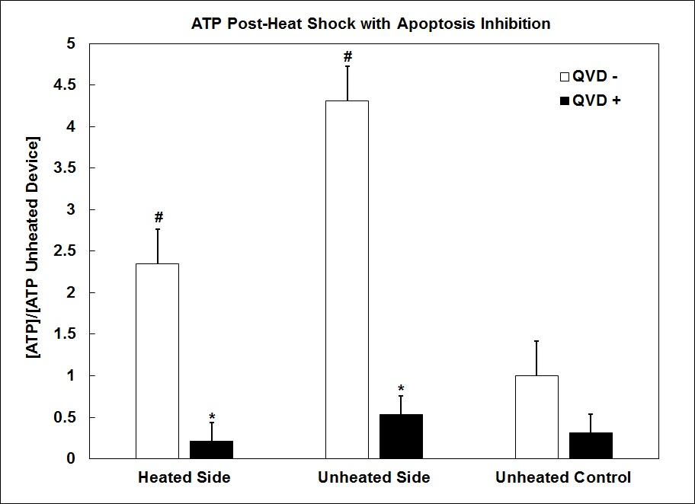
RANKL Reporter with Heat Stress
Figure 15: Change in RANKL and OPG gene expression relative to unheated control at 12 hrs. *p<0.05 vs QVD - unheated control.
Figure 16: ATP concentration relative to unheated QVD - control on the heated and unheated side of the Mµn at 12 hrs. *p<0.05 QVD – vs QVD + on same side. #p<0.05 vs QVD - unheated control.

Slide 12
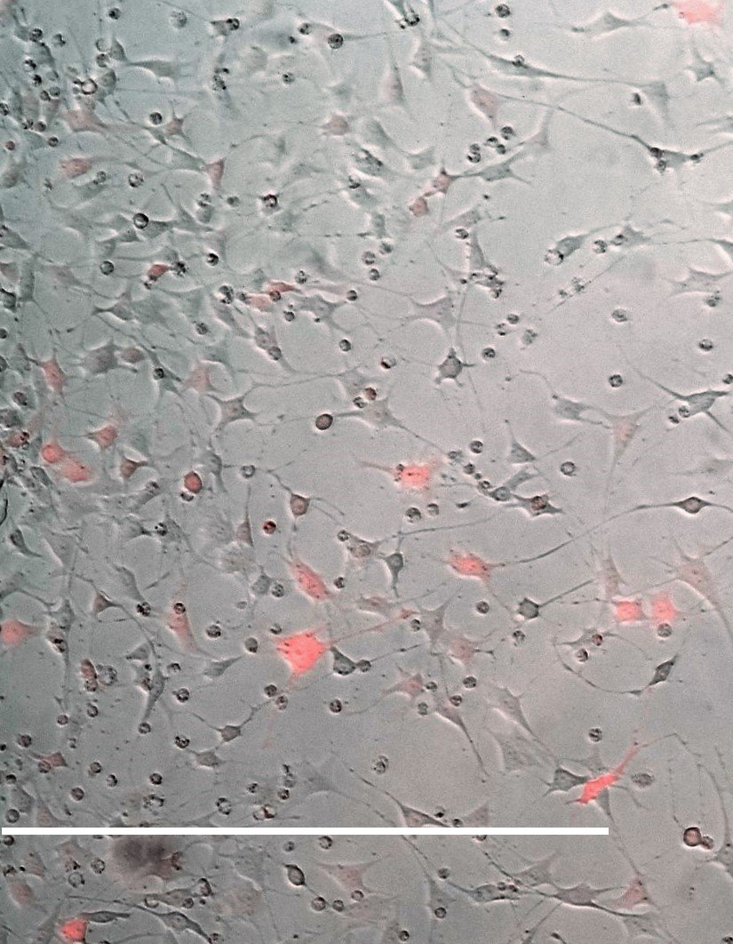
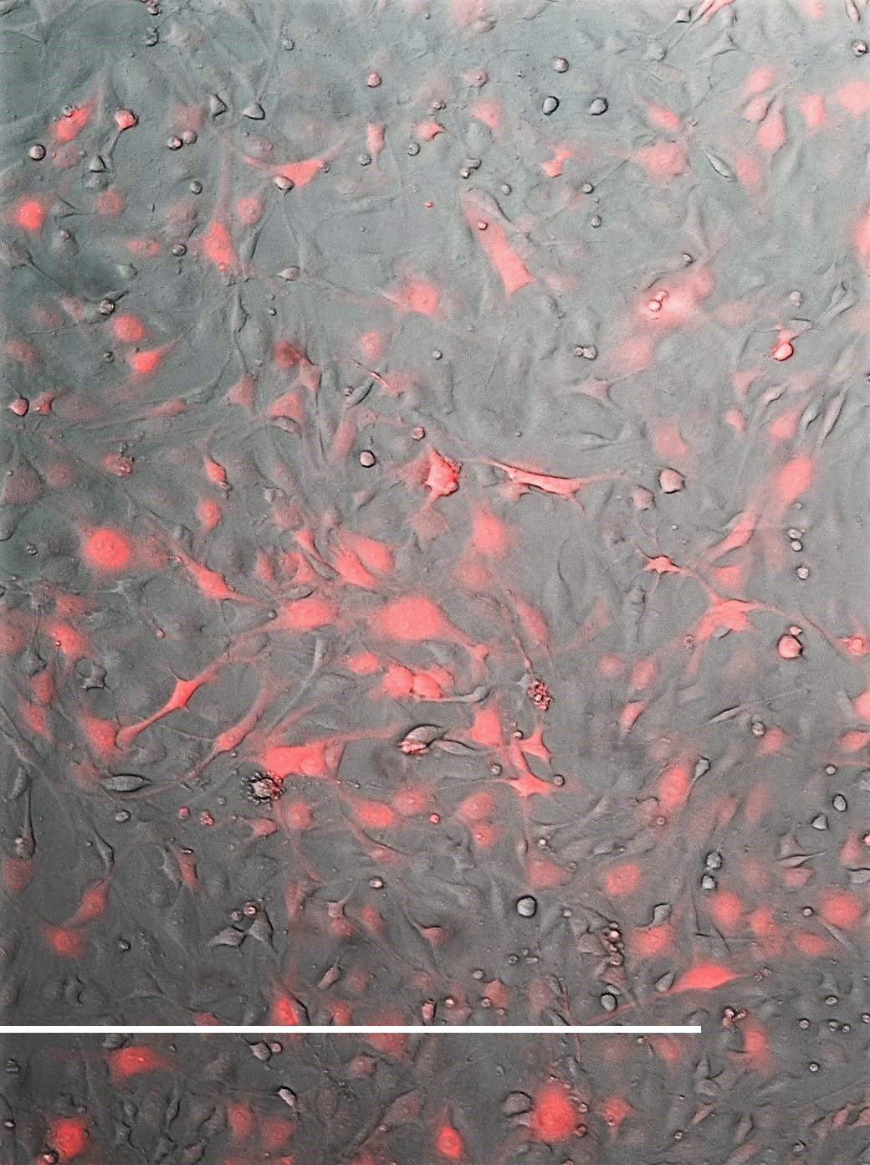
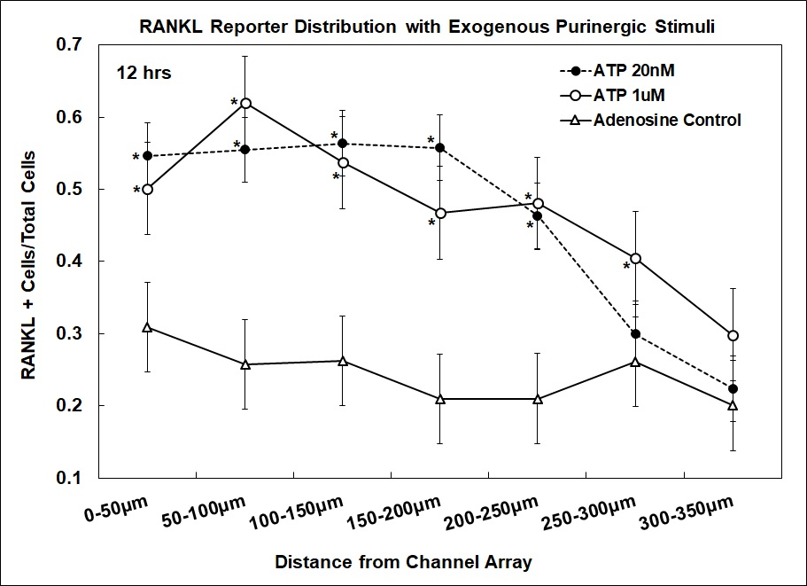
RANKL Reporter with Exogenous ATP Stimulation
1µM Adenosine
RANKL
1µM ATP
RANKL
350 µm
350 µm
Distance from Array
Distance from Array
Figure 17: MLO-Y4 RANKL reporter cells 12 hrs post-1uM Adenosine bolus release from opposite side.
Figure 18: MLO-Y4 RANKL reporter cells 12 hrs post-1uM ATP bolus release from opposite side.
Figure 19: RANKL reporter distribution as function of distance from channel array (bolus release source). *p<0.05 vs unstimulated control.

Slide 13
Summary and Future Directions
The Mµn system mimics geometric cues of the in vivo osteocyte environment and recapitulates in vivo osteocyte morphology and gap junction functionality
Both number of “RANKL activated osteocytes” and total RANKL gene expression on the unheated side are upregulated by heat stress-induced apoptosis of osteocytes on the heated side of the Mµn
The upregulation of RANKL in number of activated osteocytes and total gene expression is mimicked by bolus ATP exposure in the Mµn
Future Directions
Further examine the mechanism of bolus ATP release from apoptotic osteocytes, looking at Pannexins and P2X receptors

Slide 14



Acknowledgements
Vazquez Lab
Shawn Mishra
Tanya Singh
Kameron Starr
Stephanie Zhang
Caroline Pena
Juan Pena
Schaffler Lab
Dr. Bob Majeska
Dr. Wing Yee Cheung
Dr. Karl Lewis
Funding Sources
Collaborators
Dr. David Spray
Dr. Randy Stout
Visit seanmccutcheonphd.com for more information

Slide 15
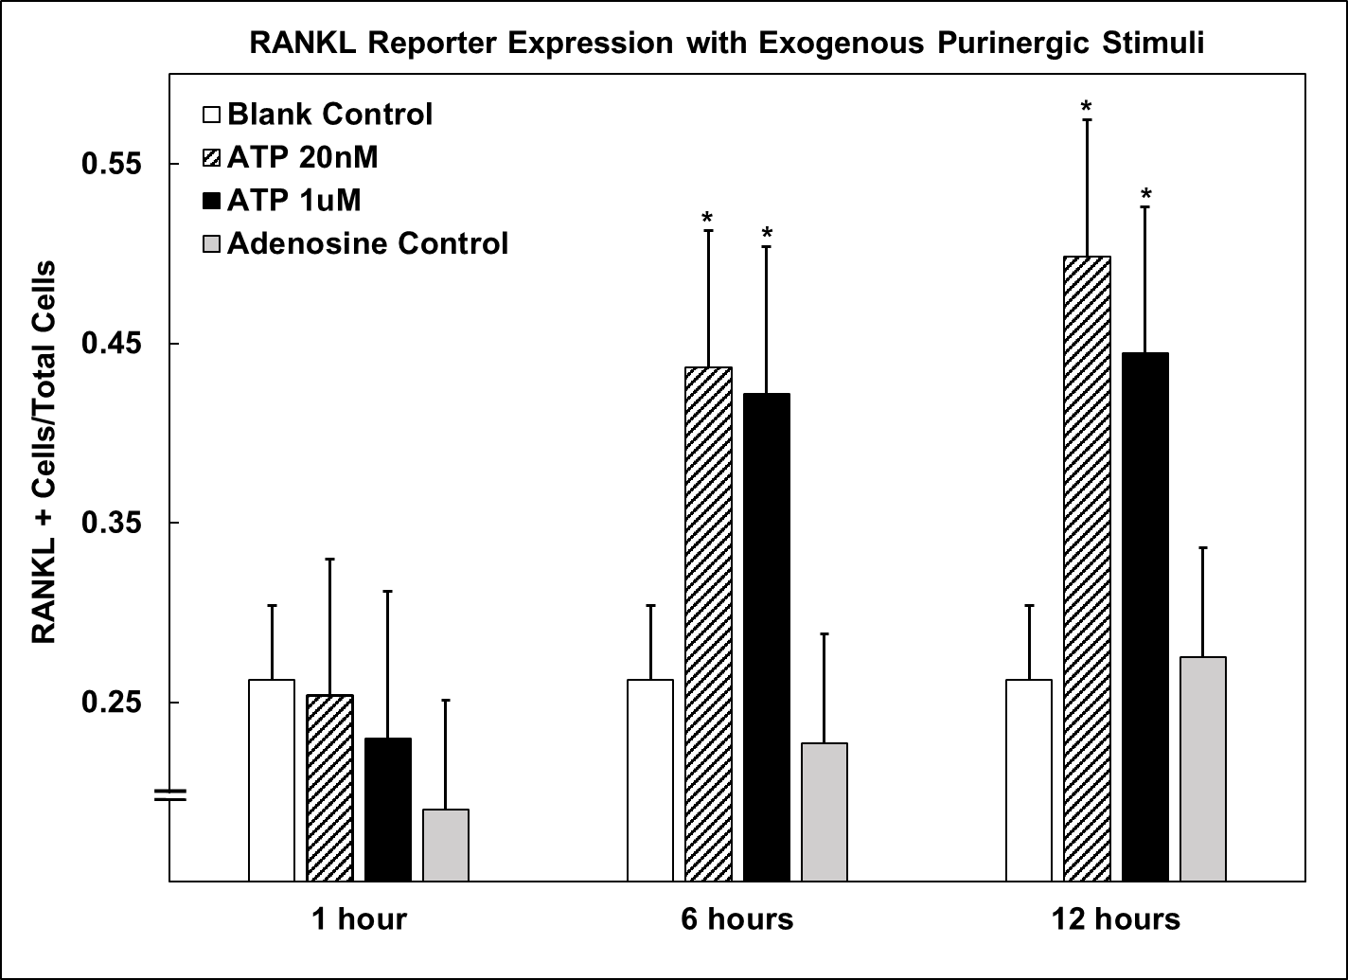
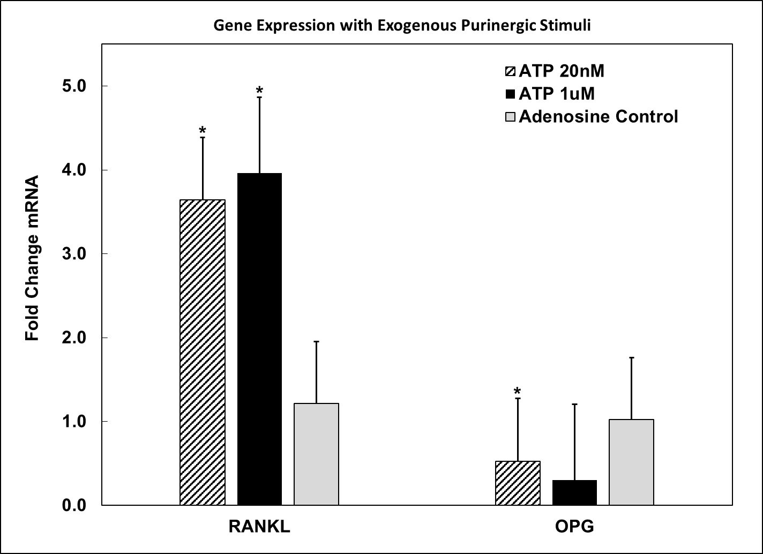
RANKL Reporter with Exogenous ATP Stimulation
Figure 20: RANKL reporter on unheated side of Mµn relative to unstimulated control at 12 hrs. *p<0.05 vs unstimulated control.
Figure 21: Change in RANKL and OPG gene expression relative to unstimulated control at 12 hrs. *p<0.05 vs QVD - unheated control.

Slide 16
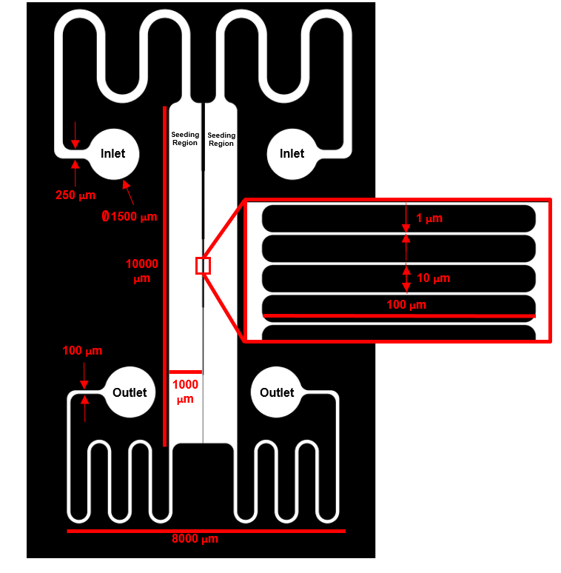
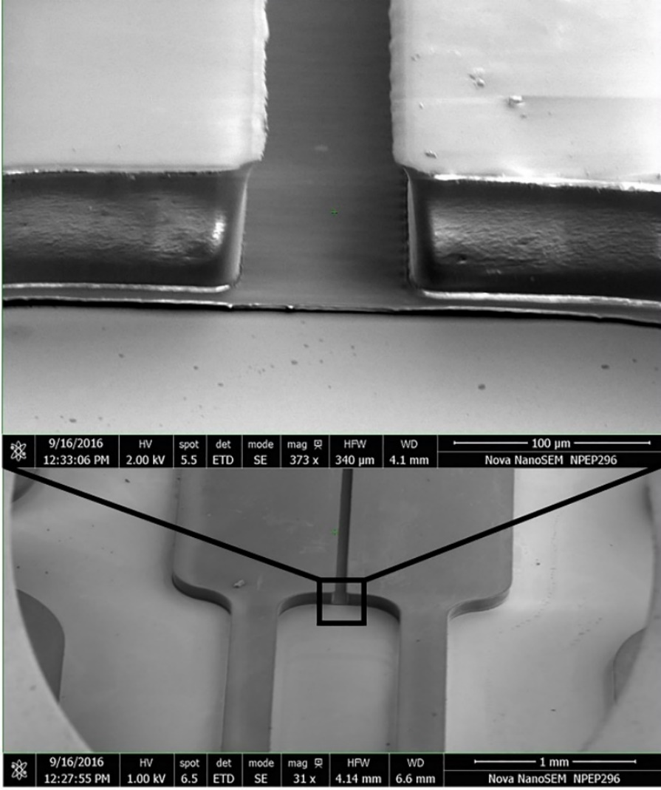
Macro-micro-nano (Mµn):
Device Design and Fabrication
Chrome on glass photomasks (<350nm wavelength filter) was designed by AutoCAD software in 2D
Master mold was produced by SU-8 negative resist photolithography
Figure 4: Device design and master mold SEM. Parallel seeding chambers separated by 1µm wide, 100µm long channels, spaced apart 10µm. 2 step photolithography with center channels at 5um and seeding regions at 50um tall.
Notes:
Macro cell seeding regions to control test group interrogation and limit mechanical force (fluid shear)
Micron scale separation of seeding regions to enable fluidic sequestration of signaling when necessary
Nano scale channel widths to approach the native scale of canaliculi
Lidan You – University of Toronto
Edward Guo – Columbia University

Slide 17
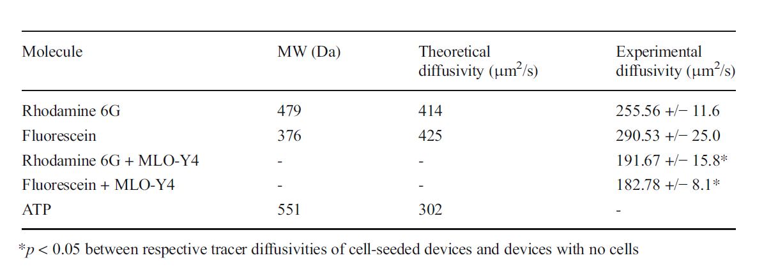
Empirical Diffusion Modeling
Fluorescein, Rhodamine and 10 kDa dextran at 10µM were used to model small molecule flux under parallel flow within the acceptable operating volumetric flow rate limits and under static conditions
Under flow there is a gradient across the channel construct with successful sequestration of diffusible molecules
Under static conditions there is free diffusion across the channel construct:
Distribution of ATP-like molecules and 10kDa dextratn across the channel array under 10uL/min parallel flow at steady state (>5min).
Notes:
Experiments with ATP-like (size and diffusivity) show similar parallel flow gradient profiles as did a larger molecule
Under static conditions a time dependent diffusion was determined using an approximation for diffusion through a porous medium, and shown to be slightly below theoretical diffusivity (collagen coating)
Critical for understanding of time scale and when to predict a signaling response on the opposite end of the array
Diffusivity through porous membrane in parallel flow. Podichetty et al. Oklahoma state University (2012)

Slide 18
Osteocyte Phenotypic Markers
MLO-Y4 osteocyte-like cells were characterized in the M-µ-n system
Cells showed >90% viability via Calcein AM staining up to 7 days
Plated on collagen I and fibronectin, cells demonstrated process formation, expected integrin distribution, and junctional protein distribution
αvβ3
β1
Cx43
Panx1
Figure 7: MLO-Y4 osteocytes plated on collagen 1 in brightfield (top left) and stained via immunocytochemistry for integrin profile (top right), Connexin 43 gap junction (bottom left) or Pannexin 1 hemichannel (bottom right)

Slide 19
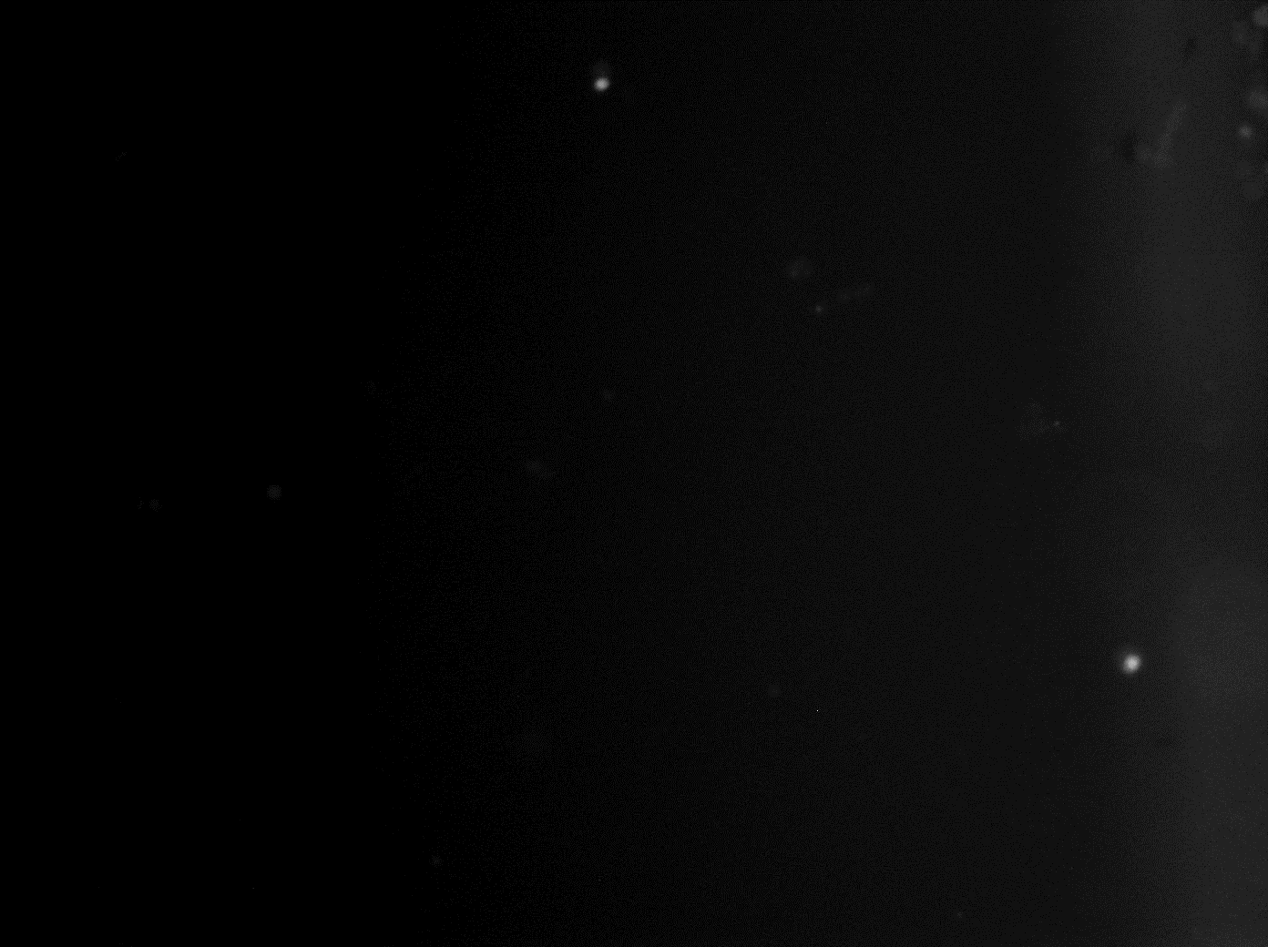
Apoptosis Induction: Caspase 3 Clevage
Apoptosis Markers
TUNEL (DNA damage, late stage)
Annexin V (Membrane inversion, early stage)
Caspase 3 cleavage (early to mid-stage)
Heat-shock Apoptosis Induction Regime
Heat cells at 40, 45, 50, 55, or 60°C
Heat for 30 or 60s
Allow heat-shock recovery for 37°C at 1, 12, or 24 hours
Test for extracellular ATP content by firefly luciferase assay and examine the apoptosis/necrosis ratio via Caspase 3/7 cleavage dye and PI
MLO-Y4 cells in live culture treated with caspase 3 cleavage indicator over 12 hours after heat shock (60°C for 30s)

Slide 20
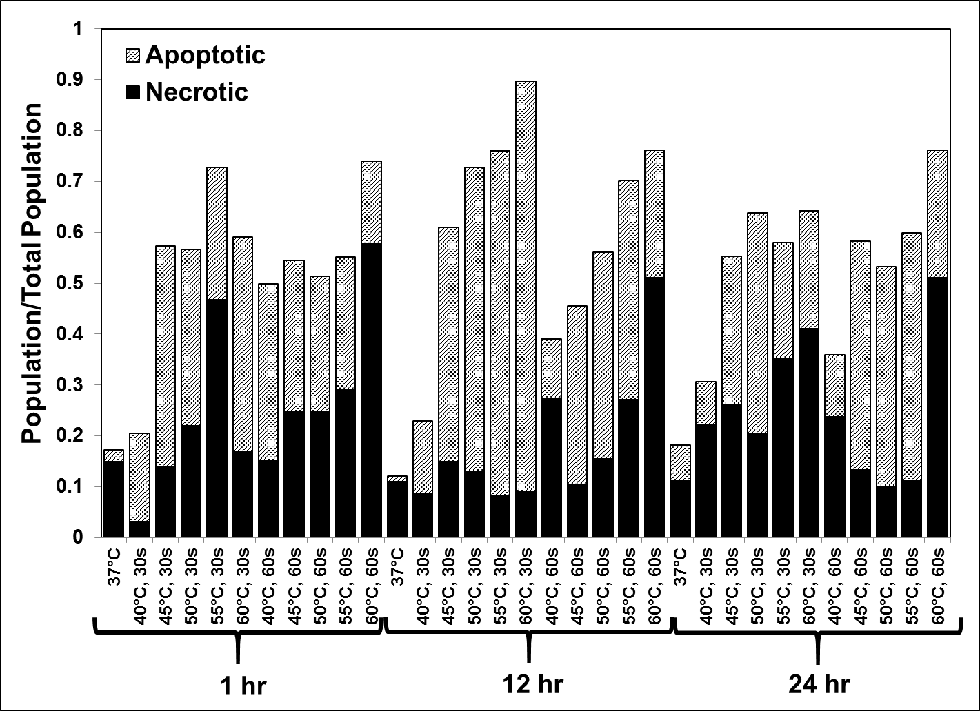
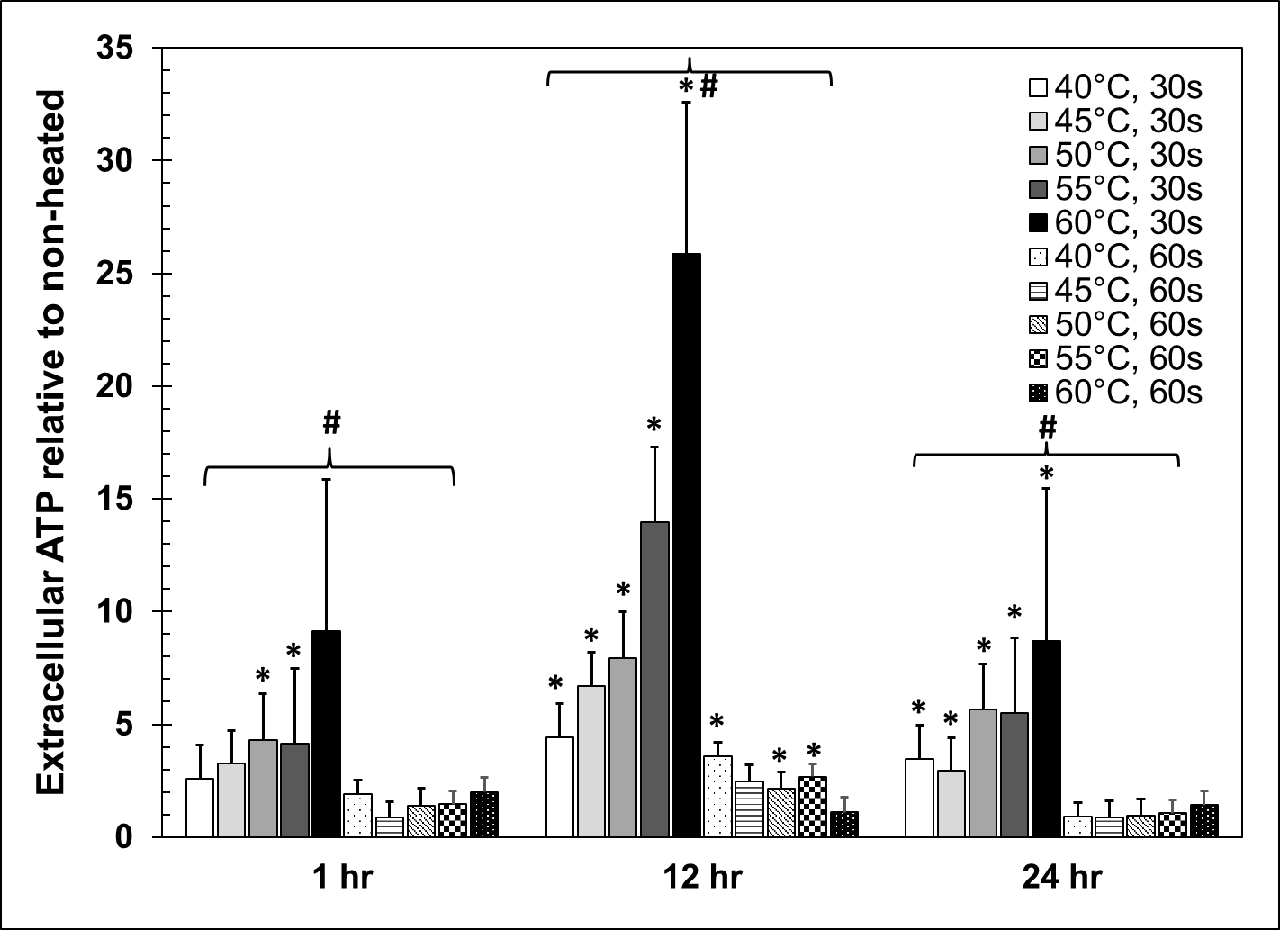
Heat Shock: Results
Increased apoptosis and necrosis with increasing temperature
Maximal apoptosis to necrosis ratio after 12 hour recovery period (8:1)
Significant increase in extracellular ATP after 30s heat-shock, with highest after 12 hour recovery
Proportion of cell population that is apoptotic or necrotic after heat-shock and recovery with the balance being healthy cells.
Relative extracellular ATP concentration after heat shock and recovery. *p<0.05 vs non-heated control. #p<0.05 between 30s and 60s heating for each recovery time point.
Notes:
Dolan et al. National University of Ireland (2012)

