Slide 1

A Nano-microfluidic Device for the Study of Osteocyte Apoptotic Signaling
Department of Biomedical Engineering
Sean McCutcheon
Vazquez Laboratory and Schaffler Laboratory
Biomedical Engineering Society Annual Meeting
October 7th, 2016

Slide 2
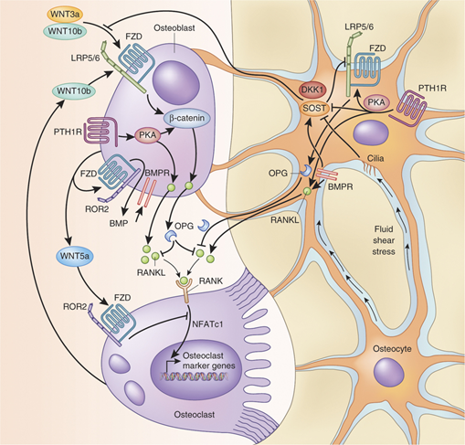
Background: Bone Signaling - RANKL
Osteocyte Role in Catabolic Signaling
Paracrine Signaling - DKK1, Sclerostin, PGEs
Endocrine Signaling - PTH
Receptor activator of nuclear factor kappa-B ligand (RANKL)
  Osteoblast precursor differentiation and the initiation of resorption
Apoptosis
  Purinergic “find me” signal and bystander effect
  Initiation of the RANKL pathway in adjacent osteocytes?
Critical determinant of bone homeostasis and mechanical integrity
Figure 1: Partial schematic of bone homeostatic signaling (Baron and Kneissel. Nat Med, 2013).
Notes:
RANKL triggers osteoclast percurosr recruitment and differentiation
Proposed that upregulation of soluble RANKL is due to purinergic signaling from apoptotic osteocytes
Critical in bone balance and mechanical integrity

Slide 3

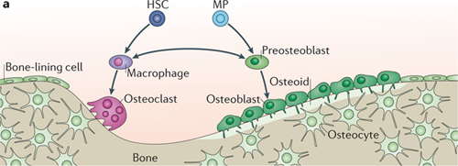
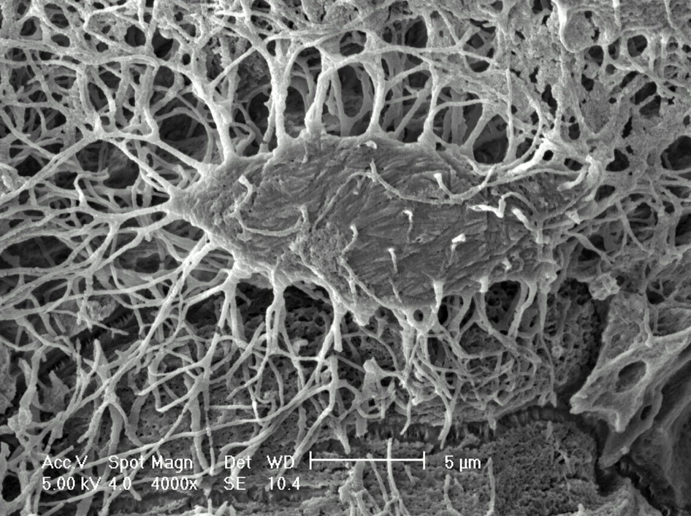
Background: Osteocyte In Vivo Geometry
Figure 2: Bone Cell organization (Long. Nature Reviews Molecular Cell Biology, 2012).
Figure 3: SEM of osteocyte (Pajevic. IBMS BoneKEy, 2009).
Bone Cell Geometry
Osteoblasts and osteoclasts sit on the bone surface, while osteocytes reside within the confined Lacunar Canalicular System (LCS)
  The osteocyte cell body sits in a 8-20µm diameter lacuna
  Osteocyte processes extend into 100-200nm diameter canaliculi
Notes:
Osteoblasts exist within highly confined space called the LCS
They communicate with each other and cells on the bone surface by means of their processes
The communication is dependent on interactions (mechanobio and diffusible signaling) within these nanometer scale spaces

Slide 4
Approach Outline
Device Design and Fabrication
Diffusion (Diffusible Signaling) Control and Measurement
Osteocyte Characterization in the Device
Apoptosis Induction
Apoptosis Regime and Purinergic Signaling

Slide 5
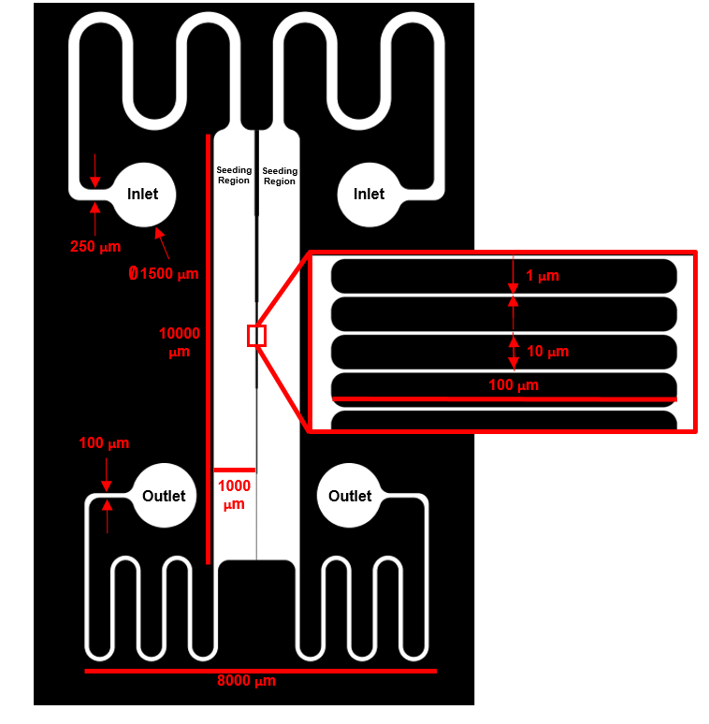
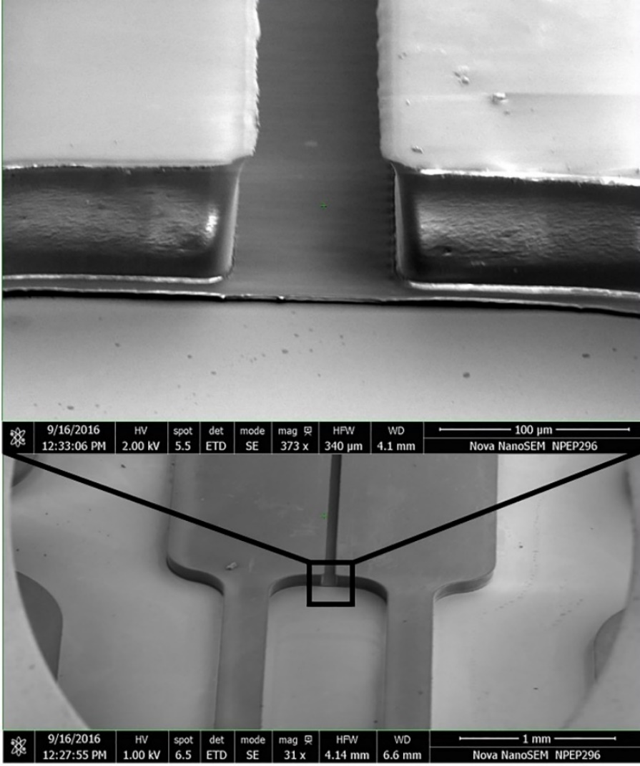
Macro-micro-nano (M-µ-n):
Device Design and Fabrication
Chrome on glass photomasks (<350nm wavelength filter) was designed by AutoCAD software in 2D
Master mold was produced by SU-8 negative resist photolithography
Figure 4: Device design and master mold SEM. Parallel seeding chambers separated by 1µm wide, 100µm long channels, spaced apart 10µm. 2 step photolithography with center channels at 5um and seeding regions at 50um tall.
Notes:
Macro cell seeding regions to control test group interrogation and limit mechanical force (fluid shear)
Micron scale separation of seeding regions to enable fluidic sequestration of signaling when necessary
Nano scale channel widths to approach the native scale of canaliculi
Lidan You – University of Toronto
Edward Guo – Columbia University

Slide 6
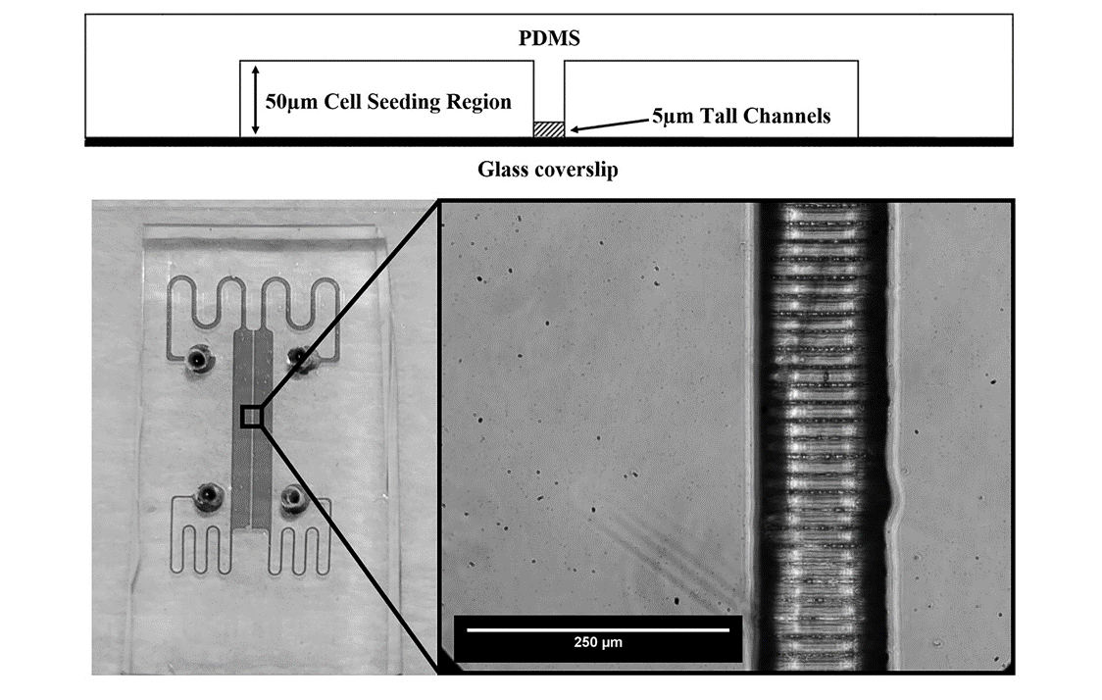
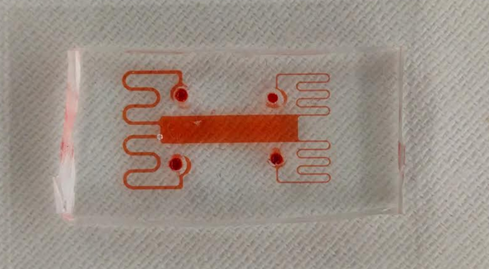
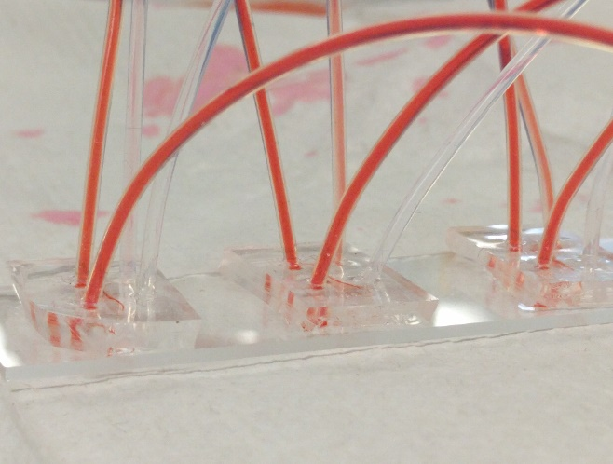
M-µ-n: Device Design and Fabrication
The SU-8 photoresist on Si mold was silanized and used to cast PDMS devices.
Devices were bonded to glass slides by ozone plasma treatment.
Channel widths measure 500nm -1µm and have bumpy structure due to lithographic processing
Channel topography may mimic “hillock” structure where osteocyte processes anchor to canalicular walls via integrins
Figure 5: Profile view of bonded device and brightfield images of visualized PDMS device with successful channel resolution (left) with fluidic connections (right)
Notes:
Able to demold from Si/Su-8 master utilizing silanization and resolve channels
Able to form fluidic seal and have fluid flow within the nanochannels
Image shows fluidic setup

Slide 7
Empirical Diffusion Modeling
Fluorescein, Rhodamine and 10 kDa dextran at 10µM were used to model small molecule flux under parallel flow within the acceptable operating volumetric flow rate limits and under static conditions
Under flow there is a gradient across the channel construct with successful sequestration of diffusible molecules
Under static conditions there is free diffusion across the channel construct:
m
)
Figure 6: Distribution of ATP-like molecules and 10kDa dextratn across the channel array under 10uL/min parallel flow at steady state (>5min).
Notes:
Experiments with ATP-like (size and diffusivity) show similar parallel flow gradient profiles as did a larger molecule
Under static conditions a time dependent diffusion was determined using an approximation for diffusion through a porous medium, and shown to be slightly below theoretical diffusivity (collagen coating)
Critical for understanding of time scale and when to predict a signaling response on the opposite end of the array
Diffusivity through porous membrane in parallel flow. Podichetty et al. Oklahoma state University (2012)

Slide 8
Osteocyte Phenotypic Markers
MLO-Y4 osteocyte-like cells were characterized in the M-µ-n system
Cells showed >90% viability via Calcein AM staining up to 7 days
Plated on collagen I and fibronectin, cells demonstrated process formation, expected integrin distribution, and junctional protein distribution
αvβ3
β1
Cx43
Panx1
Figure 7: MLO-Y4 osteocytes plated on collagen 1 in brightfield (top left) and stained via immunocytochemistry for integrin profile (top right), Connexin 43 gap junction (bottom left) or Pannexin 1 hemichannel (bottom right)

Slide 9
Process Ingrowth
MLO-Y4 osteocyte-like cells were characterized in the M-µ-n system for interaction with the channel array
Some processes partially traversed the 100um distance between cell-seeding chambers and some connected to other cells across the barrier
Figure 8: MLO-Y4 osteocytes seeded within the device adjacent to nanoscale channels. Black arrows show process ingrowth into the channel array.
Figure 9: MLO-Y4 osteocytes seeded within the device extending processes across channel array. Green staining indicates live, Calcein AM positive cells.

Slide 10
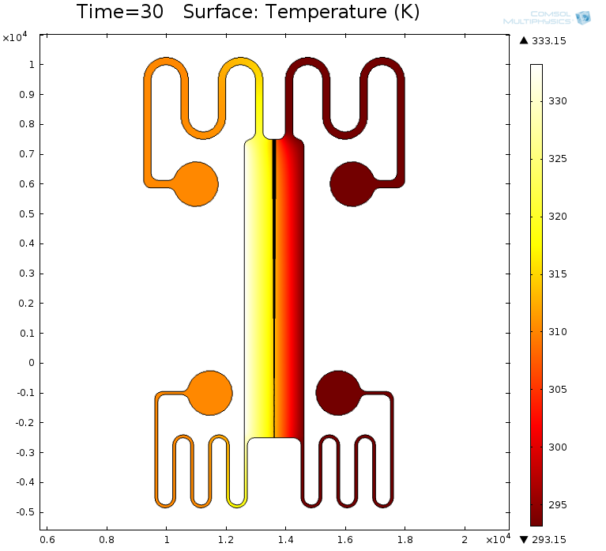
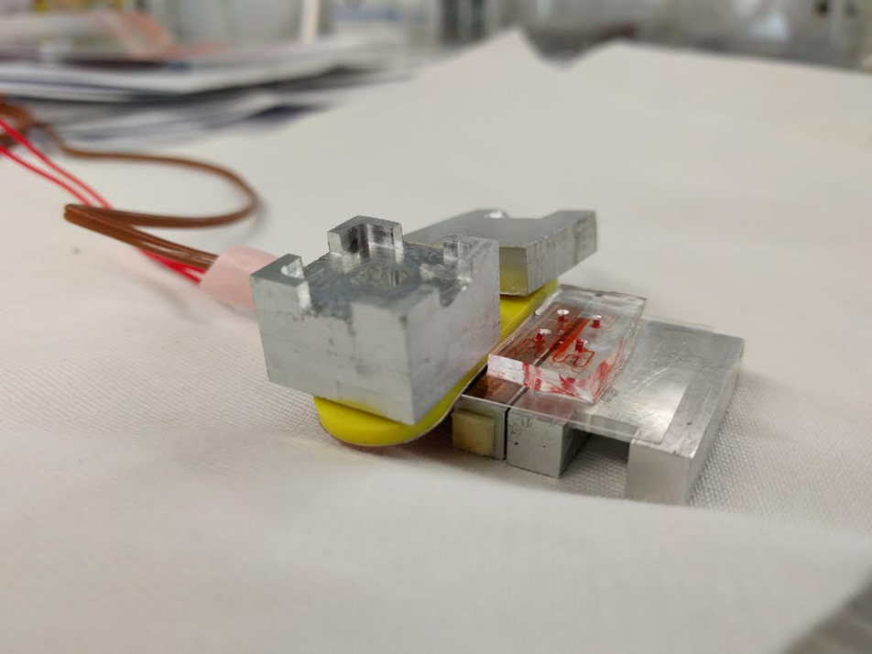
Apoptosis Induction: Heat Shock
Heat sequestration within device possible
Temperature max on unheated side = 37°C
Heating Element
Heat Sink
Figure 10: Heat distribution within the device with 60°C (333 K) heat source on left and 20°C (293 K) sink on right after 30 seconds.
Figure 11: Heating apparatus
Notes:
Heat on the untreated side doesn’t go over 310K (37C)

Slide 11
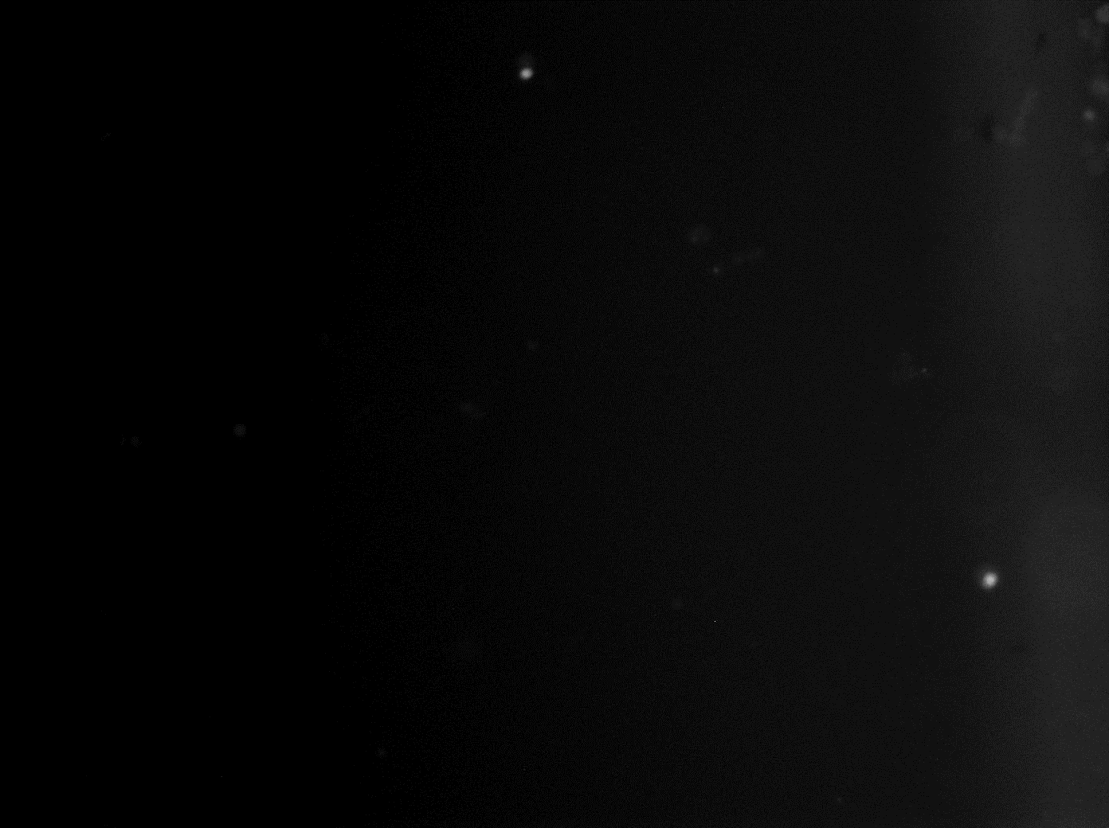
Apoptosis Induction: Caspase 3 Clevage
Apoptosis Markers
TUNEL (DNA damage, late stage)
Annexin V (Membrane inversion, early stage)
Caspase 3 cleavage (early to mid-stage)
Heat-shock Apoptosis Induction Regime
Heat cells at 40, 45, 50, 55, or 60°C
Heat for 30 or 60s
Allow heat-shock recovery for 37°C at 1, 12, or 24 hours
Test for extracellular ATP content by firefly luciferase assay and examine the apoptosis/necrosis ratio via Caspase 3/7 cleavage dye and PI
Figure 12: MLO-Y4 cells in live culture treated with caspase 3 cleavage indicator over 12 hours after heat shock (60°C for 30s)

Slide 12
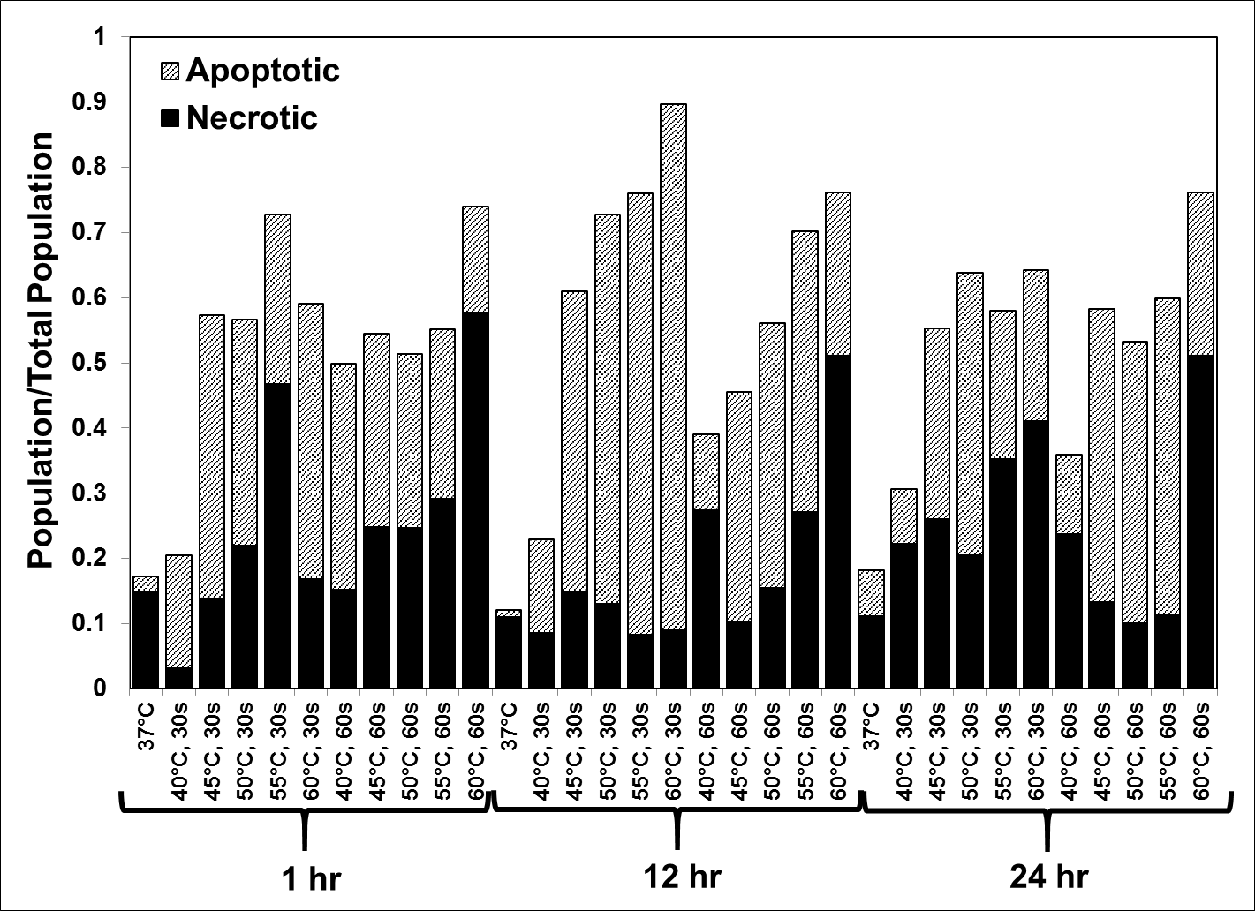
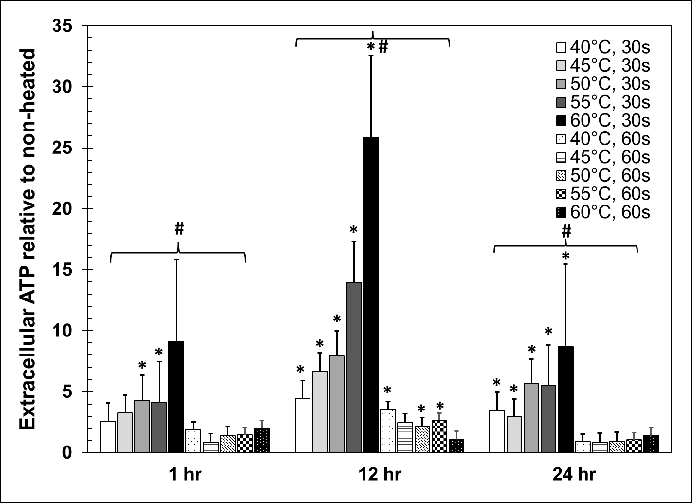
Heat Shock: Results
Increased apoptosis and necrosis with increasing temperature
Maximal apoptosis to necrosis ratio after 12 hour recovery period (8:1)
Significant increase in extracellular ATP after 30s heat-shock, with highest after 12 hour recovery
Figure 13: Proportion of cell population that is apoptotic or necrotic after heat-shock and recovery with the balance being healthy cells.
Figure 14: Relative extracellular ATP concentration after heat shock and recovery. *p<0.05 vs non-heated control. #p<0.05 between 30s and 60s heating for each recovery time point.
Notes:
Dolan et al. National University of Ireland (2012)

Slide 13
Summary and Future Directions
A device, deemed the M-µ-n system, has been designed and fabricated to mimic geometric and chemical cues seen by osteocytes in vivo
Data show the ability to sequester diffusible signaling, as well as seed MLO-Y4 osteocytes with high viability and interaction between compartments
Osteocyte apoptosis and bolus release of ATP is proposed as the initiating signal for bone resorption. Heat shock was shown to induce apoptosis and subsequent increase in extracellular ATP in MLO-Y4 populations
Future Directions
Quantify RANKL upregulation in tandem with apoptosis induction in terms of spatial and temporal resolution within the M-µ-n system
Quantify the spatial and temporal relationship between RANKL expression and ATP concentration within the M-µ-n system

Slide 14



Acknowledgements
Vazquez Lab
Shawn Mishra
Tanya Singh
Ankush Thakur
Nihan Dugler
Denise Robles
Jennifer Rico
Schaffler Lab
Dr. Bob Majeska
Dr. Wing Yee Cheung
Karl Lewis
Funding Sources
Collaborators
Dr. David Spray

Slide 15
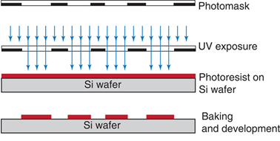

Device Fabrication Concepts
Photolithography: Lithographic process which utilizes light sensitive polymers to produce a design on a coated substrate. The most common substrates are monocrystalline Silicon (Si) and glass (SiO₂). Resolution defined by diffraction limit (300-400nm).
Photoresist – Positive or negative tone
Mask
Exposure light source, typically UV
Bake steps
Development
Soft lithography: Using a lithographically produced hard material mold to cast polymeric and elastomeric devices.
Diffraction Limit:
Figure 12: Soft lithography process flow (Mazutis et al, Nature protocols, 2013).
Notes:
R = resolution
K = system/material constant
Lamda = wavelength
NA = numberical aperature

Slide 16
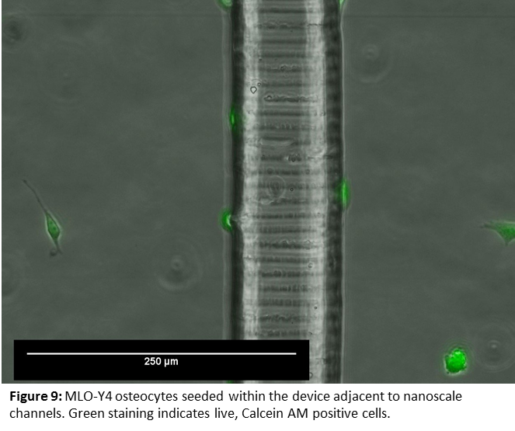

Slide 17
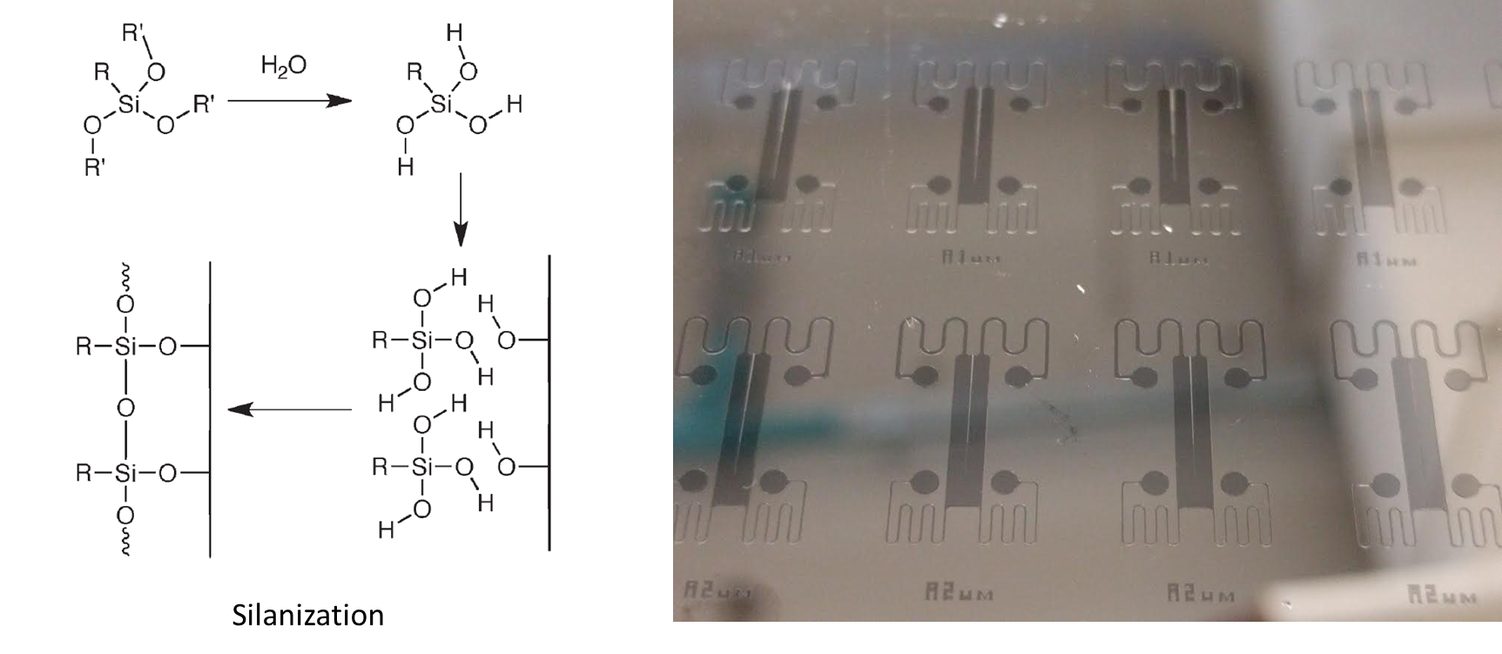
SU-8 on Si Fabrication

Slide 18
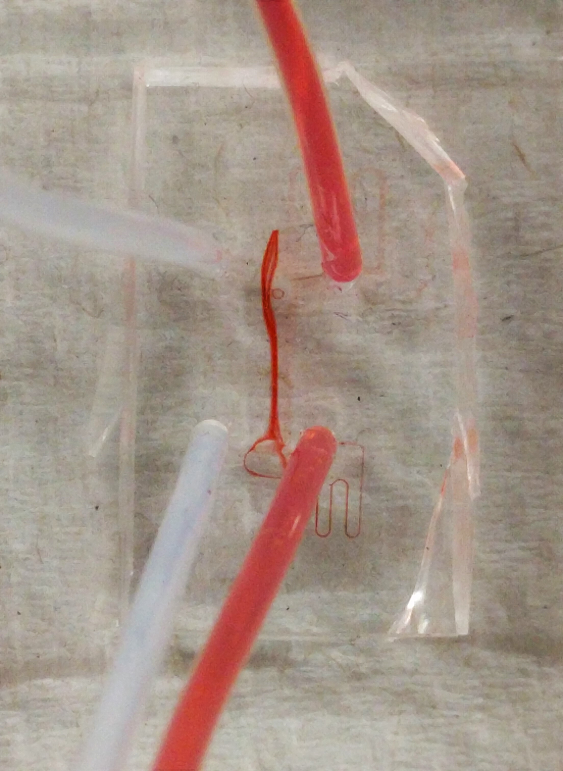

Fluid Modeling
Parallel Flow device
  Two inputs and two outputs aligned with adjacent cell seeding regions
  Flow necessary for cell viability under maintenance conditions to remove metabolites and to sequester pharmaceutical treatments
Laminar flow
  Must maintain laminar flow in each region to prevent unwanted mixing and elevated/unpredictable shear conditions. Laminar flow is approximated by Reynold’s number below 2300/where streamlines do not cross.
Shear stress limitations
  Due to small cross-sectional area (particularly height), shear stress is elevated
  Must determine the volumetric flow rate that maintains shear stress below 8 dynes/cm²
Governing Equation:
Mixing
Figure 6: Parallel flow at 100µL/min (turbulent regime, Re = 2400) visualized by food coloring source (right) and PBS source (left).
Notes:
Navier Stokes
Top = inertial forces
PI = pressure forces
Mew = viscous forces
F = external forces
Boundary conditions – Newtonian incompressible fluid, initial velocity and pressure =0, no slip condition at the wall, inlet u = outlet u, fluid material properties modeled as water
rho = density
u = velocity term
P = pressure
I = index matrix
Mew = dynamic viscosity
T = Temperature
F = external forces
Pcarrotu = 0 – Newtonian fluid

Slide 19
Computational Fluid Modeling
10µL/min
Above threshold increase in eddies, amplified fluid velocity. To maintain laminar flow Q < 95µL/min
Shear stress below 8 dyne/cm² at Q < 7.5 µL/min
Figure 7: Velocity profile of flow through device demonstrating laminar flow at 10 μL/min inlet flow rate, Re = 239, with minimal crossflow and low shear stress

Slide 20

Diffusion Modeling
Purinergic bolus release after apoptosis
  It is proposed that bolus ATP release after osteocyte apoptosis acts as a “find me” signal to trigger adjacent osteocyte to upregulate RANKL production and initiating osteoclastogenesis
  It is therefore necessary to model diffusion of ATP from the apoptosis induction region across the channel structure into the untreated region (bystander region)
Geometric constraints of the LCS
  The bolus release of ATP is highly localized in nanometer spacing between canalicular walls and osteocyte processes
Diffusivity
  For ATP at 37°C in aqueous solution, D = 300 µm²/s
Governing Equation:
Notes:
Fick’s law of diffusion
Initial conditions: ATP concentration = 0 on both sides
Boundary conditions: wall flux = 0, ATP relase at 70pM/m2-s
Fluid modeled as water and diffusivity modeled as ATP in aqueous solution
C = concentration
t = time
D = diffusivity
u = velocity
N = molar flux
R = reaction rate – i.e. rate of ATP release

Slide 21
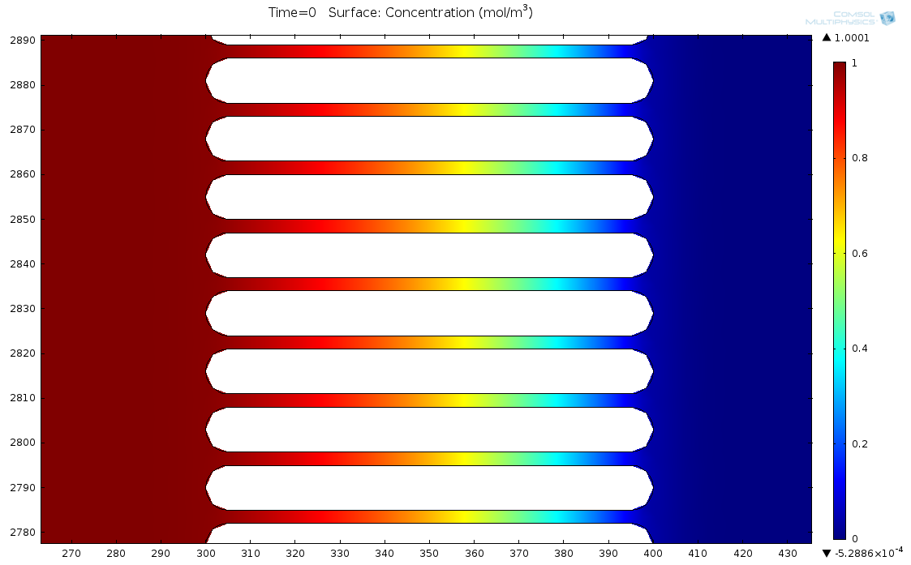
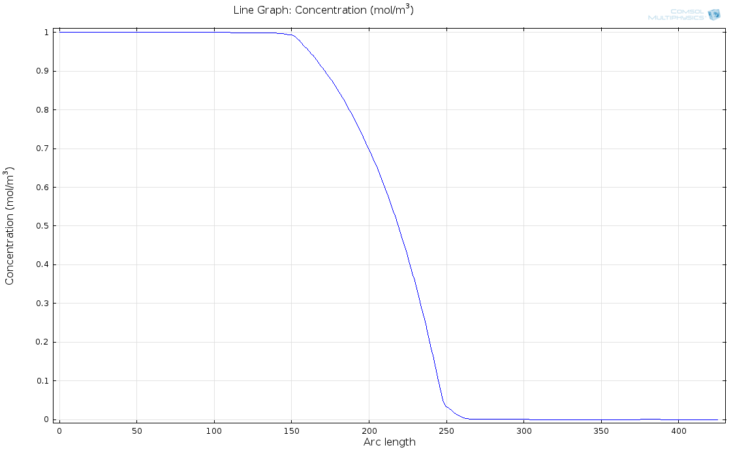
Computational Diffusion Modeling
Modeled parallel flow with in the Mµn system to determine fluidic sequestration of soluble factors at low volumetric flow rates
Assumed diffusible solute properties of ATP (302 µm²/s)
Concentration profile found at steady state (>5min)
Figure 6: Modeled concentration heat map and profile for ATP –like molecule across the channel barrier under 10uL/min parallel flow with one side at normalized concentration of 1 and the other at normalized concentration of 0.
Notes:
ATP like molecule to access purinergic signaling response
Under parallel flow to demonstrate signal sequestration (control of when to start signaling)
Demonstrates ability to set up a gradient which may help process ingrowth into channels

Slide 22

Heat Transfer
Heat-shock of osteocytes to induce apoptosis
  Heat-induced osteocyte apoptosis is a clinically relevant factor in implant surgery
  Dolan et al showed that heat-shock induced osteocyte apoptosis and necrosis up to 60°C with varied ratios after recovery
Temperature control
  PID feedback operated heating system
    PID controller
    Flat copper thermocouple
    Flat flexible heating element
Heat sequestration in the device
  Must find a method to prevent unwanted heat treatment of opposite seeding region from apoptosis induction
    Heat source and sink must be made of highly conducive materials and readily separated
Governing Equation:
Notes:
Heat transfer in fluids
Initial conditions: Fluid 37C, side 1 60C, side 2 20C
Boundary Conditions: thermal insulation of edge material
Materials modeled as water for fluid, and glass, pdms for bottom and walls
Rho = density
Cp = specific heat
T= temperature
t = time
u = velocity
k = thermal conductivity
Q = heat source
Qvh = viscous heating
Wp = Work pressure

Slide 23
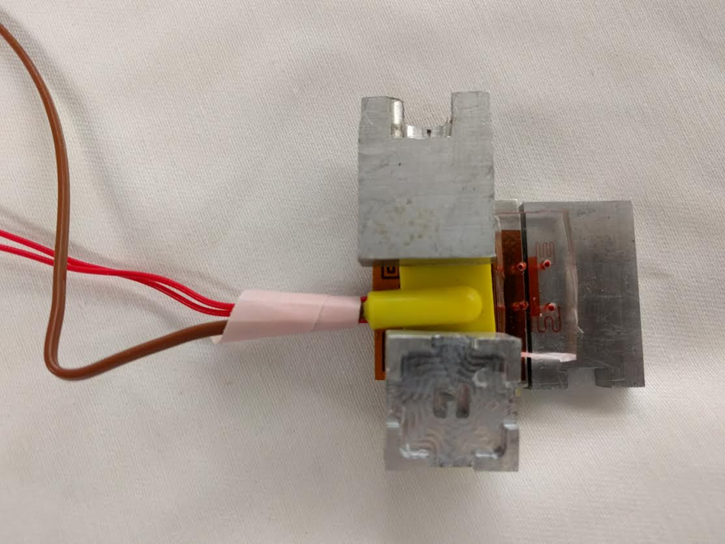
Heating setup – top down view

Slide 24
Viability Markers
Live/Dead
  Live: Calcein AM – Fluoresces in cytosol of live cells due to hydrolytic degradation by esterases
  Dead: Membrane impermeable nucleotide dyes – Propidium idodide (PI)
Integrin profile
  Osteocytes have been demonstrated to express α_{v}β₃ integrins on the cell process and β₁ integrins on the cell body
Junctional protein profile
  Osteocytes have localized Connexin 43 at process cell-cell junctions
  Pannexin 1 is a ubiquitous on membrane

